Slide 1

Lecture7:
Introduction and natural resources
(Energy resources: Renewable and non renewable energy sources, use of alternate energy sources, growing energy needs, case studies)

Slide 2
Learning outcomes
After completing this lecture
Student will get knowledge about importance and benefits of energy resource.
Student will understand the importance of alternative energy resources.

Slide 3
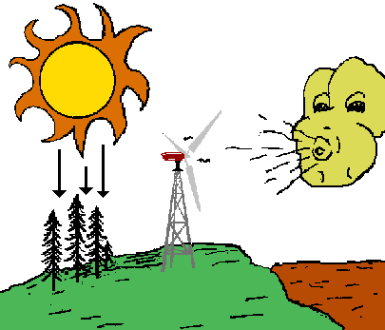
Energy Resources
All living creatures on the earth, either it is a plant, an animal or a microbe need energy to perform their vital functions. The earth is a storehouse of energy. The fossil fuels under its surface, the wind and water on its surface, the plants growing on it, the sunlight falling upon it, these are all sources of energy.

Slide 4
Renewable Sources of Energy Non Renewable Sources of Energy
Solar Energy Coal
Wind Energy Natural Gas and Oil
Tidal Energy Nuclear Energy
Geothermal Energy
Biomass Based Energy
https://www.youtube.com/watch?v=1kUE0BZtTRc
Tidal energy is a renewable energy powered by the natural rise and fall of ocean tides and currents. Some of these technologies include turbines and paddles.
Geothermal energy is heat derived within the sub-surface of the earth. Water and/or steam carry the geothermal energy to the Earth's surface. Depending on its characteristics, geothermal energy can be used for heating and cooling purposes or be harnessed to generate clean electricity.

Slide 5
Use of Alternative Energy Sources
According to Integrated Energy Policy Report(IEPR) prepared by the planning commission aim is that at least 10% of the power generation installed capacity in the country should come from renewable source by the end of the 11th plan period.
India is now the world’s fourth largest generator of wind energy with an installed capacity of 7093 MW
India plan to manufacture biodiesel from inedible vegetable oils. The cost of setting up a biomass plant is the same as that of a coal based power plant
https://www.youtube.com/watch?v=uXX6bnyUqA0

Slide 6
Limitations of Alternative Source of Energy
Most of the technologies involve high installation cost and require maintenance.
The material that find application in designing and manufacturing of device are not easily available. (Silicon example)
Weather problem.
Geographical problem.

Slide 7







Urban Problems Related to Energy
The energy requirement in urban areas is many times greater than that in rural areas because of the following reasons:
Activities that require large amounts of energy (industries, institutions, transportation, etc.) are concentrated in urban areas.
Urban people have a higher standard of living compared to rural people and hence demand more energy for comfortable living.

Slide 8
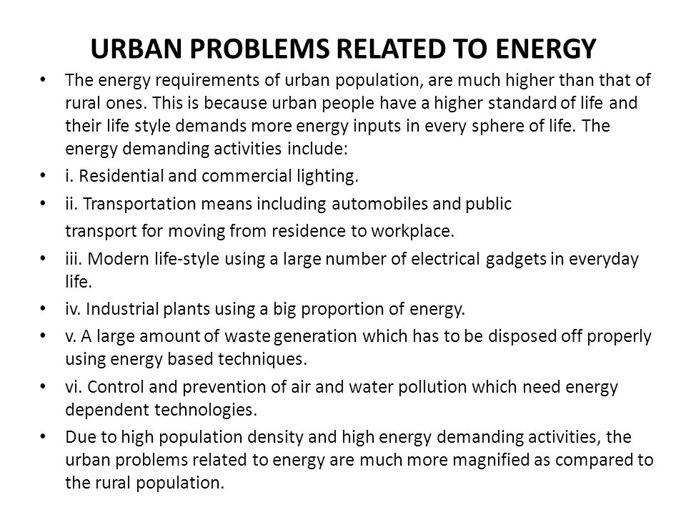

Slide 9
Methods for conservation of natural resource, and control
Establishment of organizations.
Create Act/Rules
Public Awareness
Use of 5R System
Use of scientific methods and Technology.
Follow the Disaster Management system.

Slide 10
Role of an Individual in Conservation of Natural Resources
Use recyclable resources like reuse paper page and encourage recycling.
Use alternative energy sources such as solar energy for domestic heating
Make equitable use of water for personal and domestic purposes.
Through better use and maintenance of non-maintainable resource.
Prefer to use renewable and non-conventional energy sources.

Slide 11
Important Web Links
http://ecoursesonline.iasri.res.in/mod/page/view.php?id=89590
http://intranet.bhu.ac.in/unit2.pdf

Slide 12
Acknowledgment
Some images, animation, and material have been taken from the following sources:
Textbooks: PERSPECTIVE IN ENVIRONMENTAL STUDIES by ANUBHA KAUSHIK, C P KAUSHIK, NEW AGE INTERNATIONAL PUBLISHERS
References Book: TEXTBOOK OF ENVIRONMENTAL STUDIES by D. DAVE AND S. S. KATEWA, CENGAGE LEARNING
3 All slides can be used for reading purpose only

